Slide 1

AI for DevOps bit.ly/2Rza3v7
Bernard O’Leary – DevOpsDays Wellington 2018

Slide 2
Agenda
Definitions of AI, ML and DevOps
State of the art AI and ML versus the real world
How can DevOps benefit from AI
Tools, techniques, terminology
Coding workshop: bug predictor
Notes:
I am not a maths expert (or public speaking expert for that matter)
Part of the point of this talk is to illustrate that it’s within most people’s grasp to use ML for stuff without needing to study it for years

Slide 3
Definitions

Slide 4
What is DevOps?
Doing computer stuff that helps the world in a way that:
Tries to keep people happy
Tries to improve all the time
Tries not to be stupid

Slide 5
What is AI and ML?
“Artificial intelligence (AI) is the ability of a digital computer or computer-controlled robot to perform tasks commonly associated with intelligent beings” – Britannica
Machine Learning (ML) is a “Field of study that gives computers the ability to learn without being explicitly programmed” – Arthur Samuel
“At its core, machine learning is simply a way of achieving AI” – Medium article I found
Notes:
https://medium.com/iotforall/the-difference-between-artificial-intelligence-machine-learning-and-deep-learning-3aa67bff5991

Slide 6
State of the art AI

Slide 7
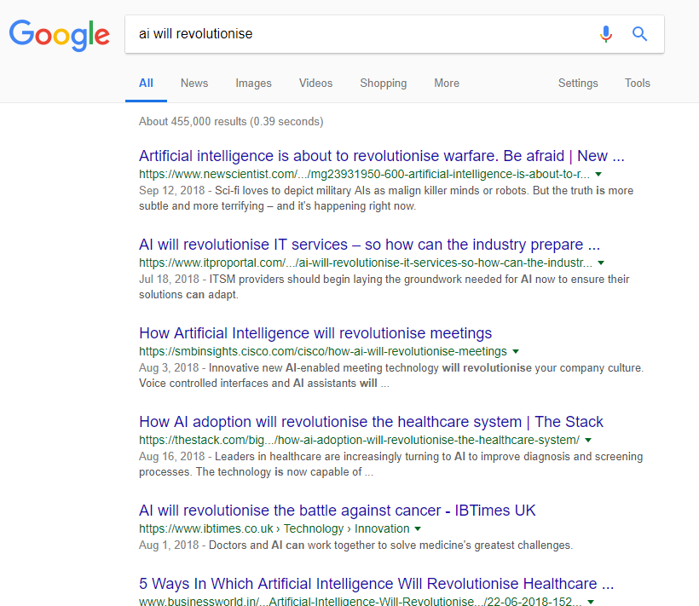
Notes:
Half a million results for this search

Slide 8
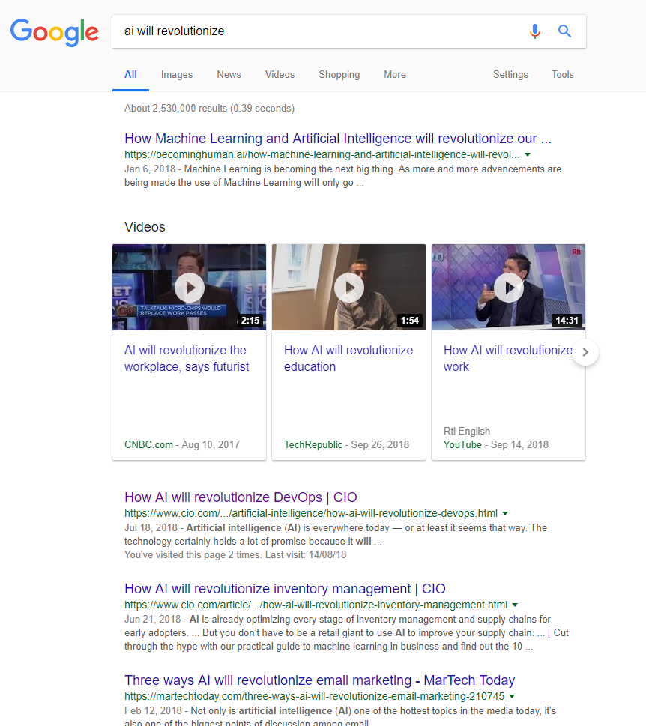
Notes:
2.5 million results if you spell revolutionize properly

Slide 9
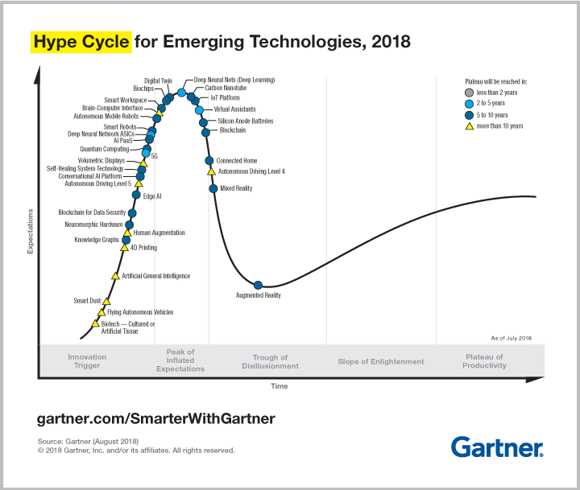
Notes:
Deep Learning is at the very top of the Emerging Trends Hype Cycle
This is for August 2018

Slide 10
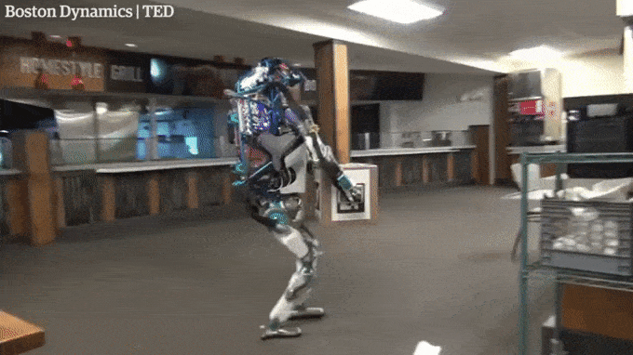

Slide 11
So how can AI actually help?

Slide 12

Notes:
But what does that mean for people in the real world?
What does it mean for everyday people such as DevOps practitioners, like these guys?

Slide 13

Notes:
AI is only ever going to be of real value to me when it becomes like ABS or Traction Control
ABS and Traction Control are always there and always ready and doing stuff, but you just don’t notice them – they provide incremental benefit
From a DevOps perspective this should also make sense, since we’re all about incremental (as opposed to revolutionary) process improvement

Slide 14

Notes:
https://www.rescam.org/

Slide 15
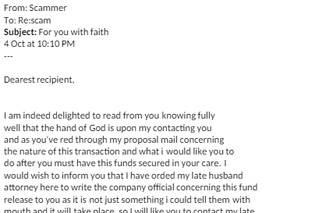

Slide 16
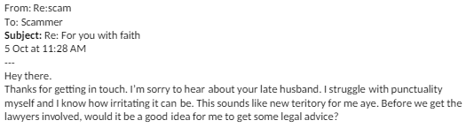

Slide 17


Slide 18
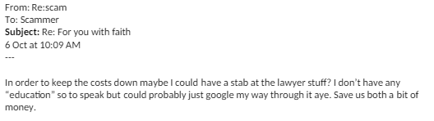

Slide 19
Why should DevOps care about AI?
AI works best when applied in modest increments
Can be scripted and manipulated easily
DevOps has lots of different types of data sources
Constantly looking for ways to improve
An AI “step” can for example be spliced into a CI/CD pipeline
Notes:
DevOps data sources include for example application logs, systems alert emails, etc.

Slide 20
Tools, techniques, terminology

Slide 21
Terms
Training set, test set
Model; training, parameters
Features/dimensions (“X”) and target (“y”)
Encoding – making everything a number
Imputation – replacing missing data
Normalisation – optimising performance

Slide 22
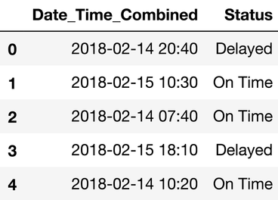
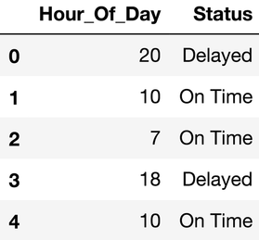
Data preparation
Data cleansing is about 80% of all ML/AI projects
Feature engineering
E.g. for date/time – splitting

Slide 23
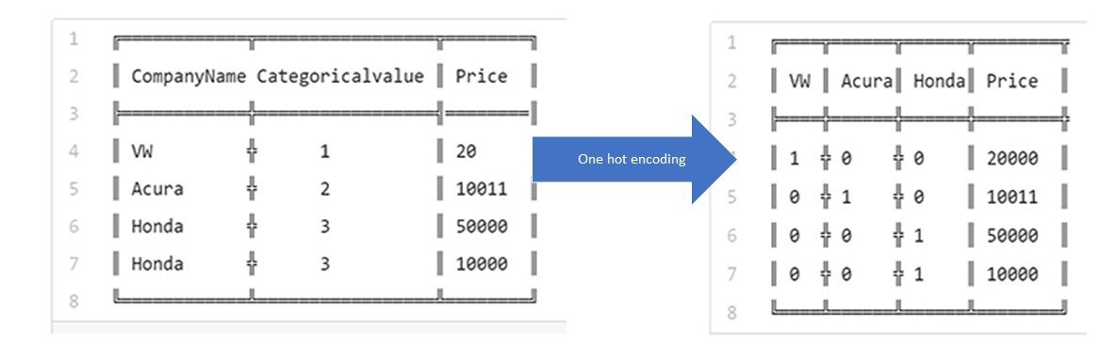
Encoding
Categorical feature encoding
One-hot encoding

Slide 24
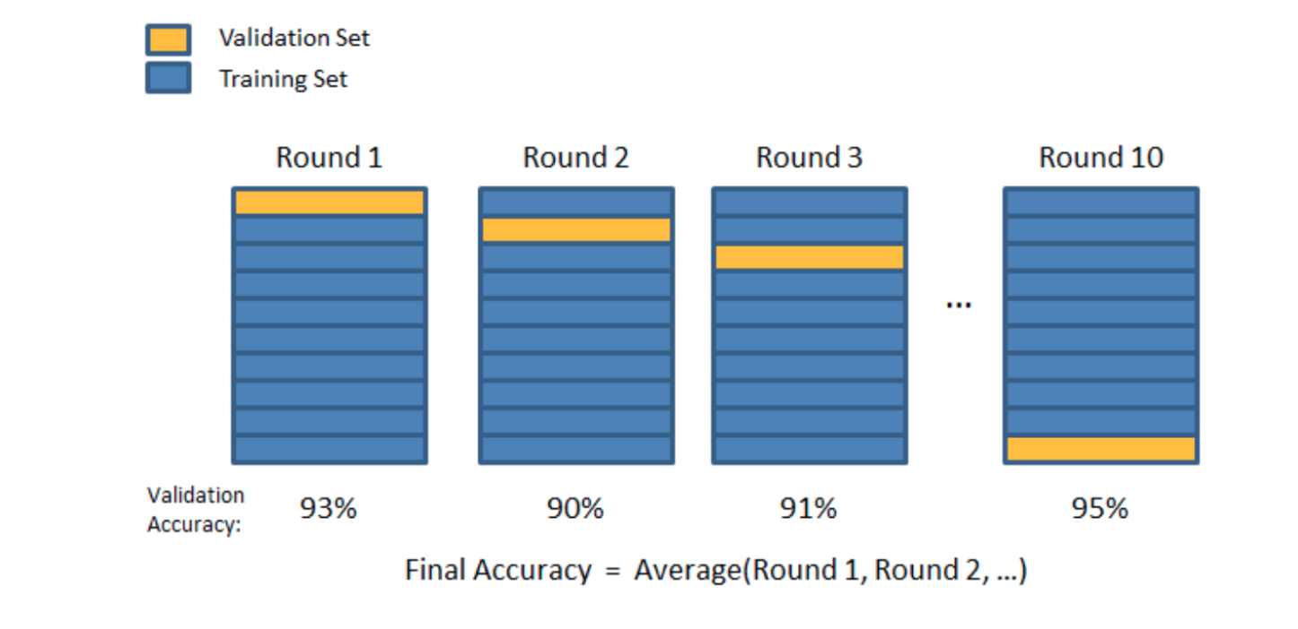
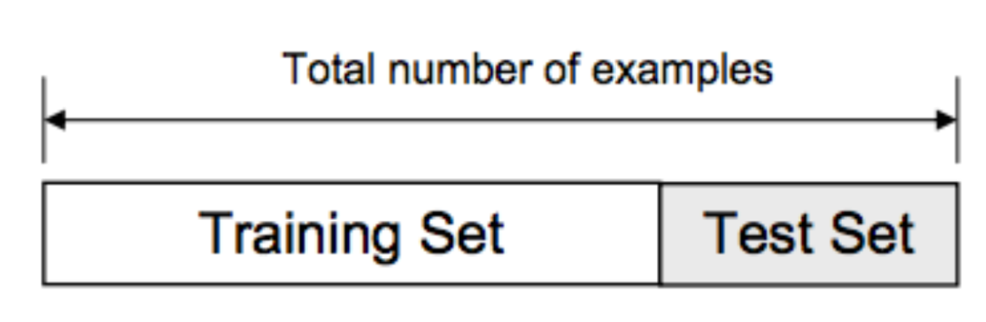
Model training, testing and scoring
Train/Test Split and Folding
Notes:
https://towardsdatascience.com/train-test-split-and-cross-validation-in-python-80b61beca4b6

Slide 25
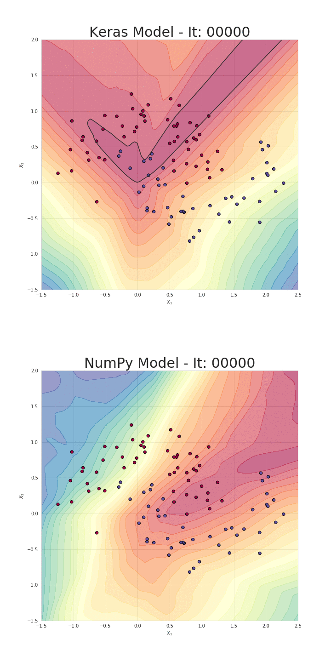
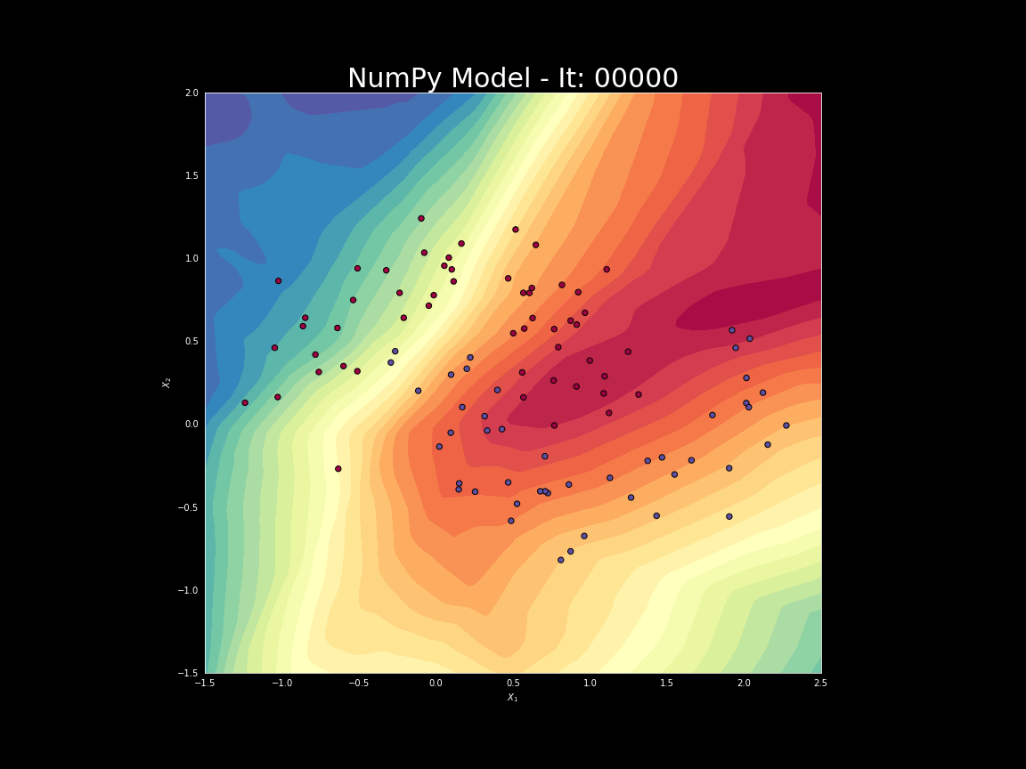
Model training
Notes:
What a machine learning algorithm does essentially is find a single function that “fits” your data.

Slide 26

Overfitting
Notes:
This diagram is oversimplified, but shows that we want the function to “model” the dataset in a way that Is specific, yet generic enough that it will be a reasonable fit for most new incoming data.
Model selection and algorithm plays a part here.
Log-log plot for visualisation - https://en.wikipedia.org/wiki/Log%E2%80%93log_plot

Slide 27
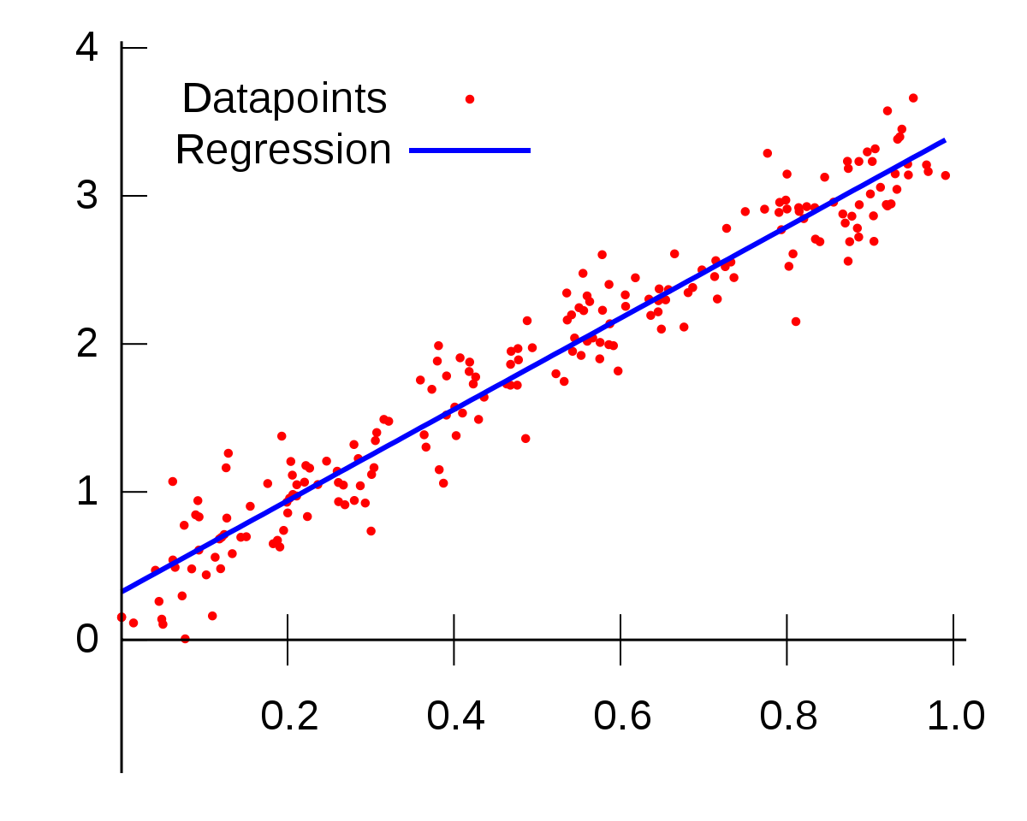
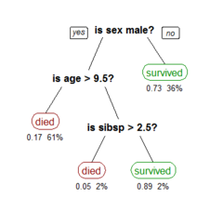
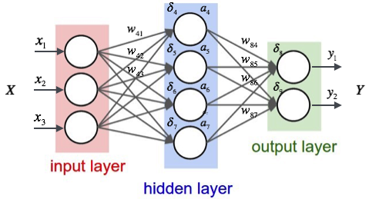
Algorithms
Linear regression
Decision tree
Neural network
Etc
Notes:
Linear Regression has notion of “Line of Best Fit”
Decision Tree has notion of “Information Gain” and “Entropy”
Neural Network has notion of “Activation Function” (e.g. Sigmoid)
Each algorithm requires different data preparation

Slide 28
Miscellaneous observations
Maths is unavoidable
Visualising the data
Use maths resources like Coursera and Kahn Academy
Cognitive Services and SaaS ML
Contrived/randomised datasets
Algorithm requirements/parameters

Slide 29







Tools

Slide 30
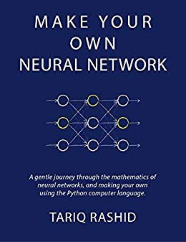
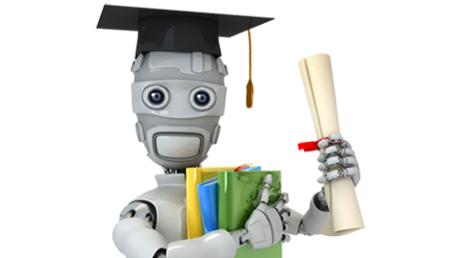



Resources

Slide 31
Coding workshop

Slide 32
The plan
Introduce Jupyter
Load up workshop Jupyter notebook
Explore workshop dataset
Data cleansing – Pandas DataFrame
Machine learning – SciKit-Learn
Operationalising – Flask

